Slide 1

project name : Development of a model fault detection in solar panels
Group 5
Team members : Ishrath Jahaan Didagur
Sarika walake
Mohammed Mubarizuddin
Sahal Asharaf
Ananya M
Divya N M
Pooja Narkhede
Mentor : Ms .Bhanupriya
Date : 23-02-2022

Slide 2
Business Problem:
To avoid installation errors and manufacturing errors of solar panels.
Business Objective :
The aim of this project is to build a model to identify the faulty solar panels and help to reduce manufacturing errors.

Slide 3
Project Architecture / Project Flow
Business problem
Data Collection
EDA
Model Building using SVM or CNN
Deployment using Flask or
Stream lit
Business problem

Slide 4
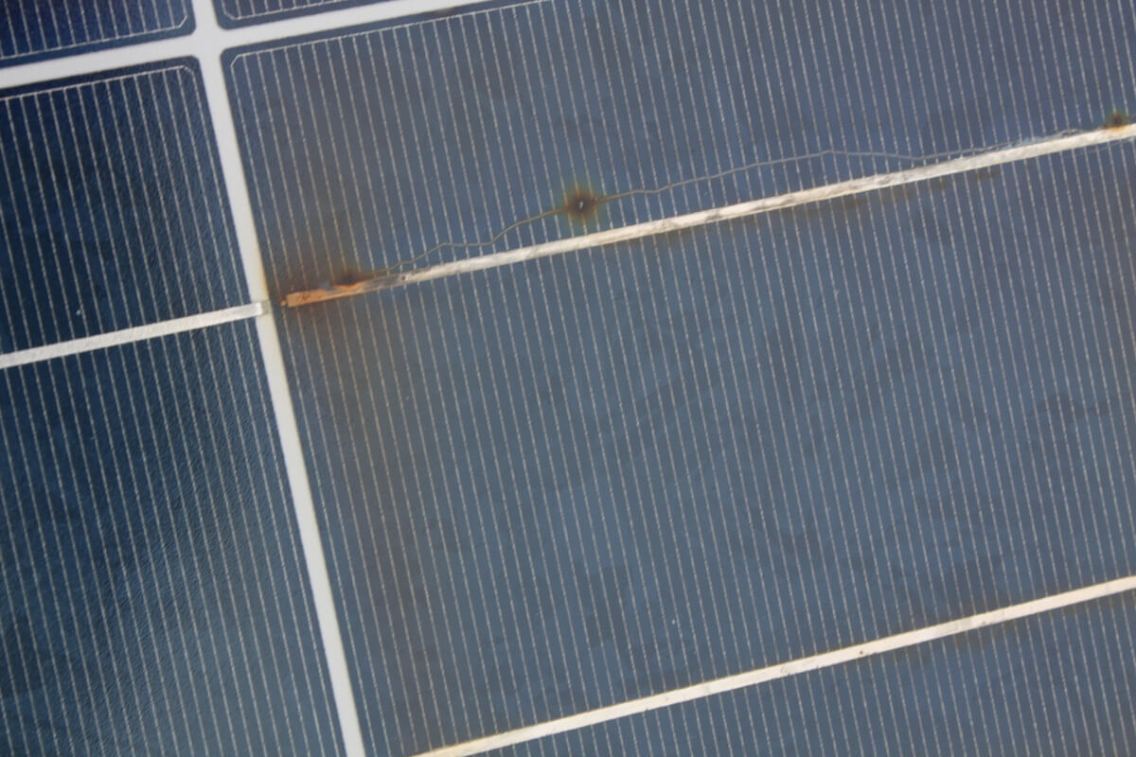
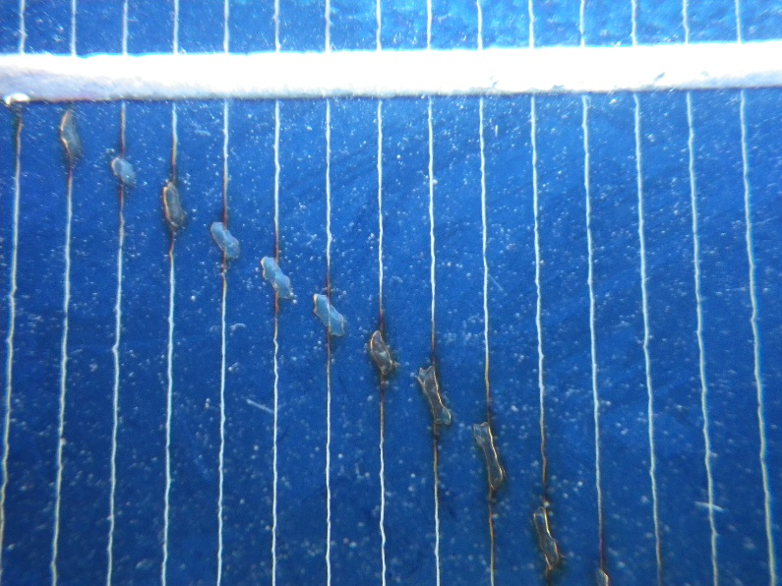
Common solar panel defects
Hot spots : Hot spots can origin, if one solar cell, or just a part of it, produces less carrier compared to the other cells connected in series. This may occur due to partially shading, dirt on the module (leaf, bird drop) or cell mismatches.
Snail trails : Snail trails are discoloration of the panel, which usually builds up over couple of years of power production on the field. Moisture can enter through the back sheet and diffuse to the cell surface.

Slide 5
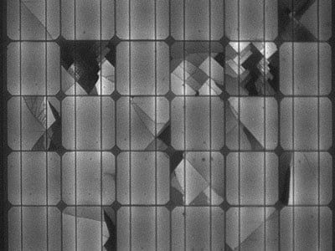
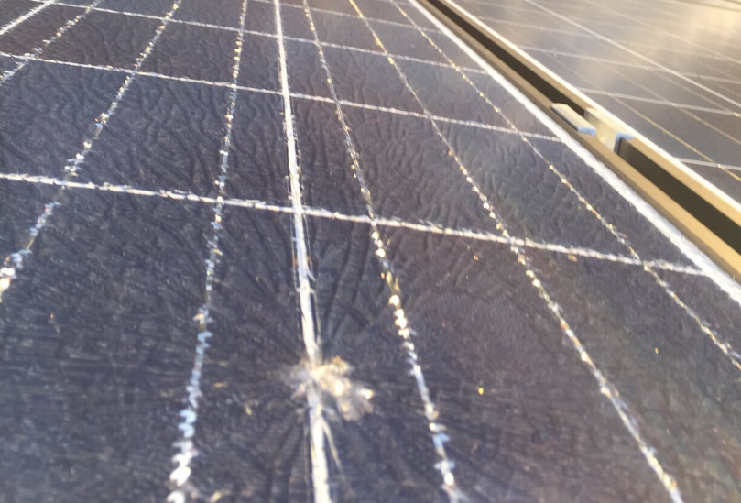
Cracked cells : Cell cracks appear in the photovoltaic (PV) panels during their transportation from the factory to the place of installation. ... These cracks may lead to disconnection of cell parts.
Broken glass : Broken glass makes solar panels more prone to future weather damages.

Slide 6
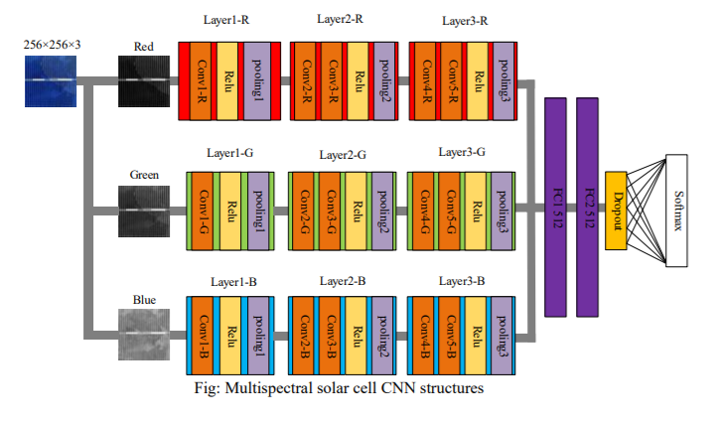
Convolutional neural network (CNN)

Slide 7
Dataset
We used a dataset consisting of labelled solar cell images, which were extracted from high resolution EL images of photovoltaic modules. All images were labelled with the help of expert who classified the solar cell images into different defect likelihood categories. Using the provided data, we trained a classifier that can predict defect probabilities in solar cells at an accuracy of 88.42% using images only. This allows us to quickly spot breakage trends in solar modules and decide whether additional measurement is useful to validate the potential loss of power efficiency.

Slide 8
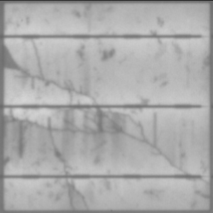
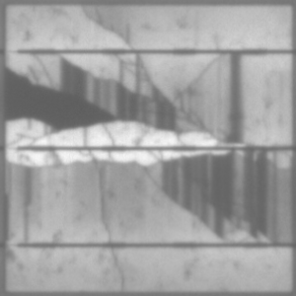
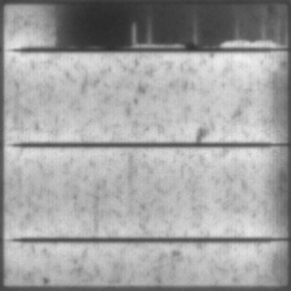
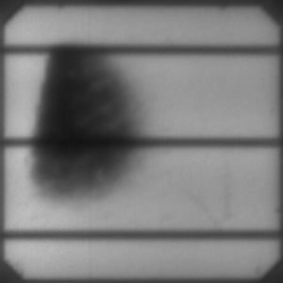

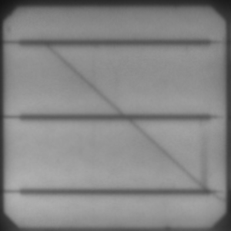
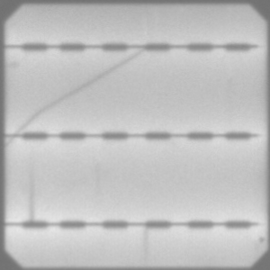
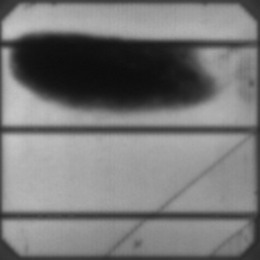
Defective Cell Images

Slide 9
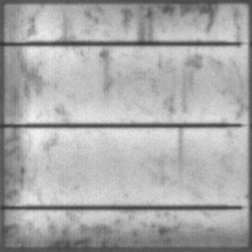
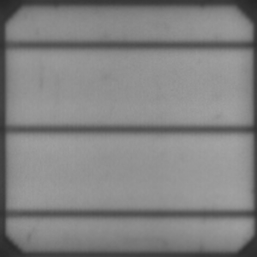

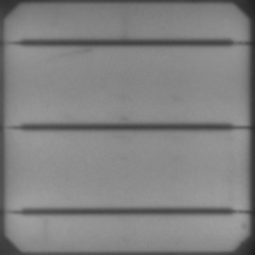

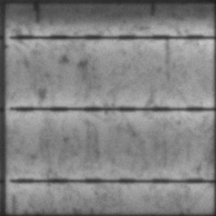


Non-Defective Cell Images

Slide 10
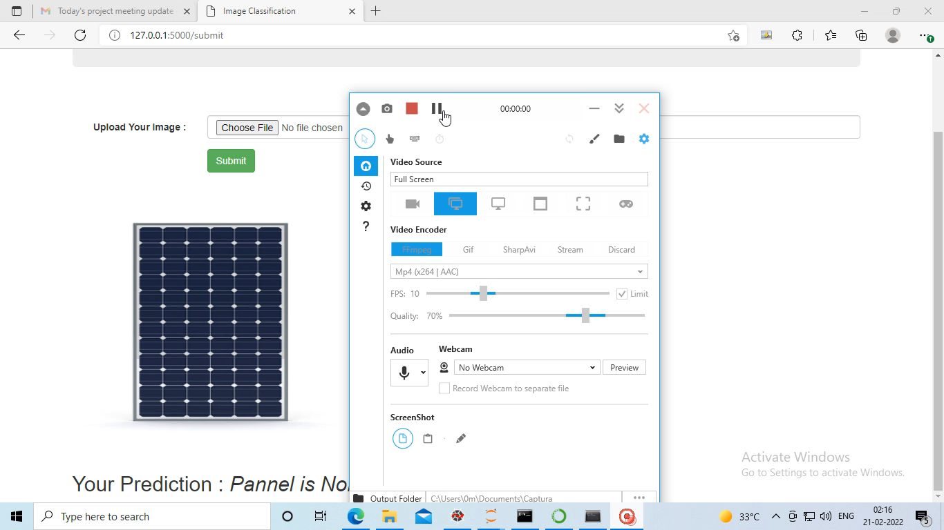
Deployment

Slide 11
References
Haiyong Chen , Yue Pang, Qidi Hu, Kun Liu. Solar Cell Surface Defect Inspection Based on Multispectral Convolutional Neural Network
Claudia Buerhop , Sergiu Deitsch, Andreas Maier , Florian Gallwitz, Stephan Berger, Bernd Doll, Jens Hauch, Christian Camus, Christoph J. Brabec. A Benchmark for Visual Identification of Defective Solar Cells in Electroluminescence Imagery.
Train Neural Network by loading your images |TensorFlow, CNN, Keras tutorial
Buerhop-Lutz, C.; Deitsch, S.; Maier, A.; Gallwitz, F.; Berger, S.; Doll, B.; Hauch, J.; Camus, C. & Brabec, C. J. A Benchmark for Visual Identification of Defective Solar Cells in Electroluminescence Imagery. European PV Solar Energy Conference and Exhibition (EU PVSEC), 2018. DOI: 10.4229/35thEUPVSEC20182018-5CV.3.15.
Deitsch, S., Buerhop-Lutz, C., Sovetkin, E., Steland, A., Maier, A., Gallwitz, F., & Riess, C. (2021). Segmentation of photovoltaic module cells in uncalibrated electroluminescence images. Machine Vision and Applications, 32(4). DOI: 10.1007/s00138-021-01191-9

